Slide 1

Predicting SpaceX Falcon 9 First-Stage Landings
IBM Applied Data Science Capstone
Dimash · SDU University, Almaty · October 2026
https://github.com/itsdimash/IBM-Data-Science-Capstone-SpaceX

Slide 2



Executive Summary
Methods
Key results
Bottom line
SpaceX REST API and Wikipedia web scraping
Wrangling into a binary landing label (Class)
EDA with charts and SQL
Folium map and Plotly Dash dashboard
Four tuned classifiers
Success rose from 0% (2013) to 84% (2020)
Orbit, launch site and payload all shift the odds
SVM, KNN and Logistic Regression tie at 83.3% test accuracy
Landing success can be predicted from pre-launch features
A predicted landing is a predicted reuse, so a cost estimate follows
Competing bidders can price against SpaceX with it
90
launches analysed
83.3%
test accuracy of the best models
66.7%
overall landing success rate

Slide 3
Introduction
Project background
PROBLEM STATEMENT
Can we predict whether the Falcon 9 first stage will land successfully, using only information known before launch?
SpaceX advertises Falcon 9 launches at about $62M; other providers charge $165M or more
Most of the saving comes from reusing the first stage
If we can predict whether stage 1 lands, we can estimate the cost of a launch
That is valuable for any company that wants to bid against SpaceX
QUESTIONS WE ANSWER
Which features drive landing success?
Does success improve over time and by site?
Which classifier predicts best?

Slide 4




Project Journey
Collect
Wrangle
Explore
Visualize
Predict
Conclude
SpaceX API and Wikipedia scraping
Clean data, create the Class label
Charts and SQL queries
Folium map and Dash dashboard
Four classifiers, tuned
Findings and insights
Each step feeds the next: one question, one dataset, one answer.

Slide 5
Methodology
Data collection · Wrangling · EDA · Interactive analytics · Modelling

Slide 6

Data Collection: SpaceX API
1
2
3
4
5
Request launches
Parse JSON
Resolve IDs
Falcon 9 only
Save dataset
GET /v4/launches/past with the requests library
response.json() then json_normalize() into a DataFrame
Helper functions call /rockets, /launchpads, /payloads and /cores
Drop Falcon 1, multi-core and multi-payload launches
Flight number, site, orbit, payload, outcome per launch
KEY PHRASES
requests.get()
json_normalize
Falcon 9 filter
to_csv
GitHub https://github.com/itsdimash/IBM-Data-Science-Capstone-SpaceX/blob/main/jupyter-labs-spacex-data-collection-api.ipynb

Slide 7
Data Collection: Web Scraping
1
2
3
4
5
Request page
Parse HTML
Find tables
Extract columns
Build DataFrame
Download the Wikipedia "List of Falcon 9 and Falcon Heavy launches" snapshot
BeautifulSoup builds the document tree
Select the launch tables by their wikitable class
Flight no., date, booster, site, payload, orbit, outcome
Combine all rows and save to CSV
KEY PHRASES
requests.get()
BeautifulSoup
find_all("table")
pd.DataFrame
GitHub https://github.com/itsdimash/IBM-Data-Science-Capstone-SpaceX/blob/main/jupyter-labs-webscraping.ipynb

Slide 8
Data Wrangling
1
2
3
4
Load data
Missing values
Count
Create Class
Read the collected launch table
PayloadMass filled with the mean; LandingPad nulls kept
Launches per site, per orbit, and mission outcomes
Turn the landing outcome into a 0 / 1 label
Landing outcome → Class
Why a binary label?
Class 1
True Ocean
True RTLS
True ASDS
Classification needs one target: 1 means the first stage landed, 0 means it did not.
Class 0
False Ocean
False RTLS
False ASDS
None None
GitHub https://github.com/itsdimash/IBM-Data-Science-Capstone-SpaceX/blob/main/labs-jupyter-spacex-Data-wrangling.ipynb

Slide 9

EDA with Data Visualization: Methodology
Chart | Variables | Purpose
Scatter | Flight Number × Launch Site | Does experience at a site improve landing success?
Scatter | Payload Mass × Launch Site | Do some sites handle heavier payloads?
Bar | Success rate × Orbit | Which orbits are easiest to land from?
Scatter | Flight Number × Orbit | Does the learning effect hold in each orbit?
Scatter | Payload Mass × Orbit | How do payload and orbit interact?
Line | Success rate × Year | Is the overall trend improving?
Feature engineering: one-hot encode Orbit, LaunchSite, LandingPad and Serial so the models can use them.
GitHub https://github.com/itsdimash/IBM-Data-Science-Capstone-SpaceX/blob/main/SpaceX_Capstone_Analysis.ipynb

Slide 10
EDA with SQL: Methodology
Display the unique launch site names
Drone-ship boosters with payload 4,000 to 6,000 kg
1
6
Show 5 records for sites starting with "CCA"
Count successful vs failed mission outcomes
2
7
Total payload mass carried for NASA (CRS)
Boosters that carried the maximum payload
3
8
Average payload mass of booster F9 v1.1
2015 drone-ship failures: month, booster, site
4
9
Date of the first successful ground-pad landing
Rank landing outcomes, 2010-06-04 to 2017-03-20
5
10
GitHub https://github.com/itsdimash/IBM-Data-Science-Capstone-SpaceX/blob/main/SpaceX_Capstone_Analysis.ipynb

Slide 11

Interactive Visual Analytics: Methodology
Folium map
Plotly Dash app
A marker and circle for every launch site
MarkerCluster: green = success, red = failure
MousePosition to read coordinates
PolyLine and distance label to coast, railway, highway and city
Dropdown: all sites or one site
Pie chart: successful launches by site
Range slider for payload mass
Scatter: payload vs outcome by booster version
Callbacks link controls to both charts
GitHub https://github.com/itsdimash/IBM-Data-Science-Capstone-SpaceX/blob/main/lab_jupyter_launch_site_location_completed.ipynb
GitHub https://github.com/itsdimash/IBM-Data-Science-Capstone-SpaceX/blob/main/spacex_dash_app.py

Slide 12
Predictive Analysis: Methodology
1
2
3
4
5
Standardize
Split
Tune
Evaluate
Select
StandardScaler on the features X; target is Class
train_test_split: 80% train, 20% test
GridSearchCV with 10-fold cross-validation
Test accuracy and confusion matrix
Highest accuracy is the best model
Logistic Regression
SVM
Decision Tree
KNN
TUNED
TUNED
TUNED
TUNED
C, penalty, solver
kernel, C, gamma
criterion, max_depth, splitter
n_neighbors, p, algorithm
GitHub https://github.com/itsdimash/IBM-Data-Science-Capstone-SpaceX/blob/main/SpaceX_Capstone_Analysis.ipynb

Slide 13
Results
EDA · SQL · Folium · Plotly Dash · Classification

Slide 14
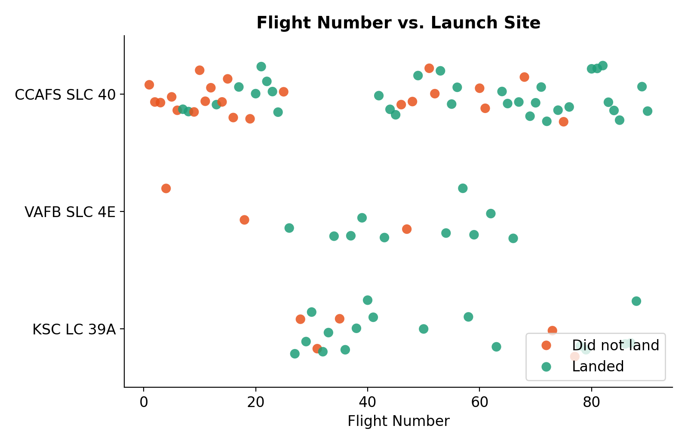
EDA: Flight Number vs. Launch Site
WHAT IT SHOWS
Each dot is one launch, coloured by landing outcome and grouped by launch site.
INSIGHT
Success rises in the second half of the launch history at every site (flights 1 to 45 vs 46 to 90): CCAFS SLC 40 from 46% to 72%, VAFB SLC 4E from 71% to 83%, KSC LC 39A from 75% to 80%.

Slide 15
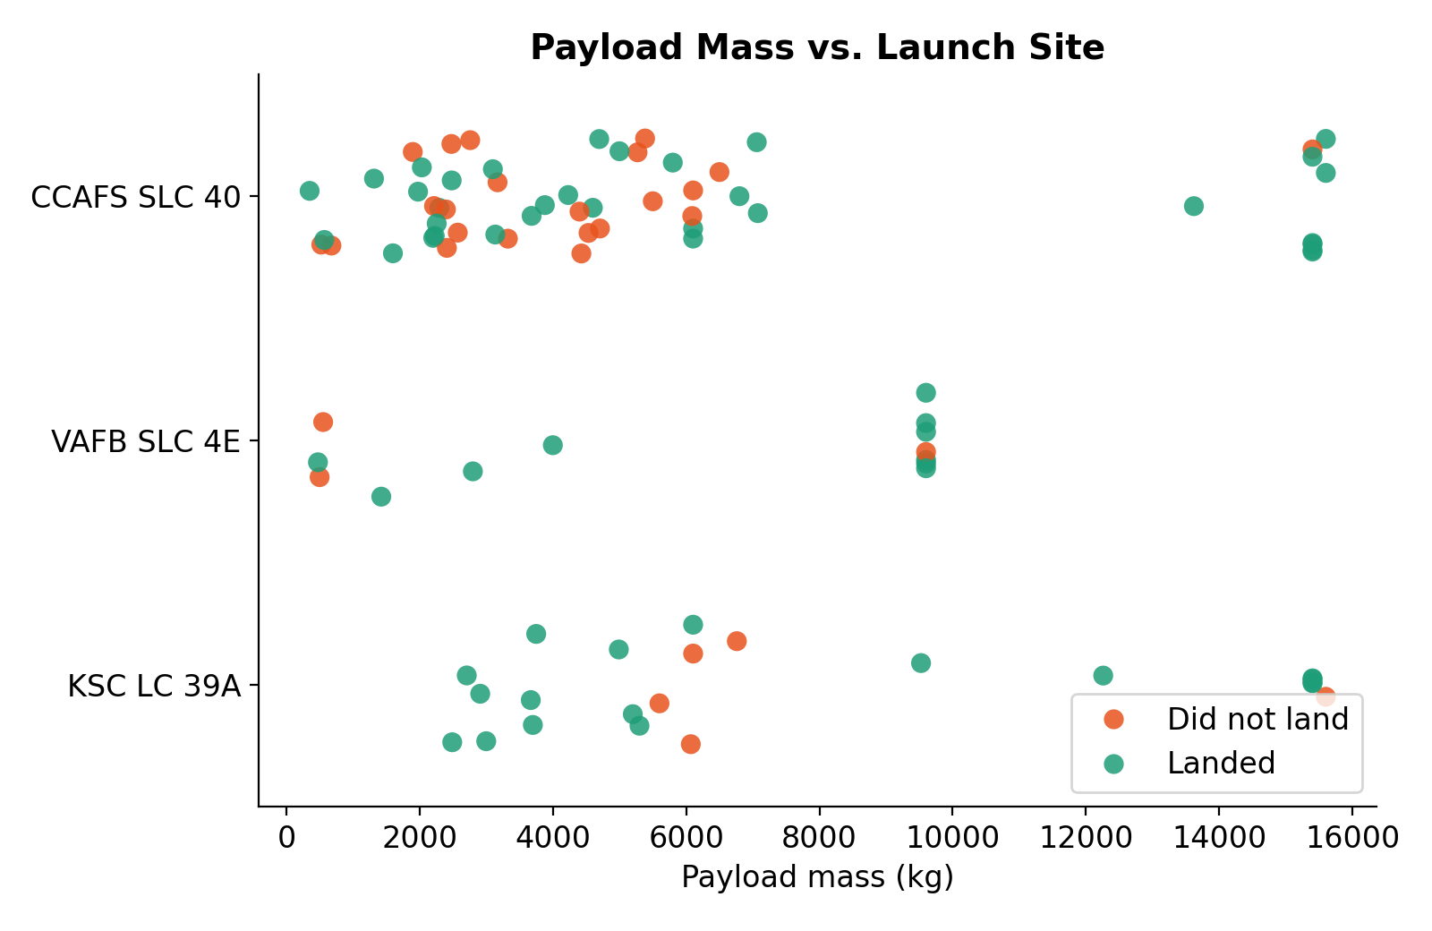
EDA: Payload vs. Launch Site
WHAT IT SHOWS
Payload mass (kg) against launch site, coloured by outcome.
INSIGHT
The heaviest payloads (up to 15,600 kg) fly from CCAFS SLC 40 and KSC LC 39A. VAFB SLC 4E has no launch above 10,000 kg (maximum 9,600 kg).

Slide 16
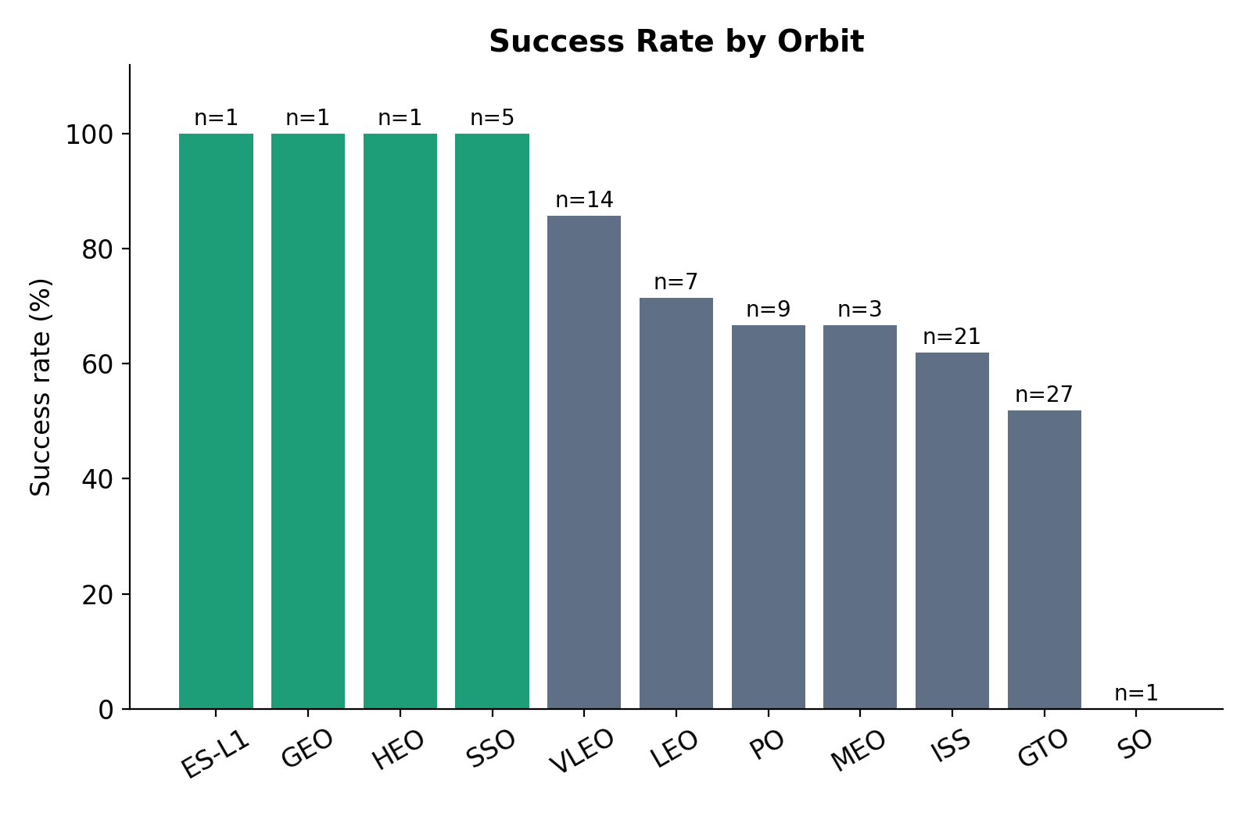
EDA: Success Rate by Orbit
WHAT IT SHOWS
The share of launches per orbit whose first stage landed, with the number of launches (n).
INSIGHT
ES-L1, GEO, HEO and SSO reach 100%, but three of them have a single launch. Among well-sampled orbits VLEO leads (86%, n=14) and GTO is hardest (52%, n=27).

Slide 17
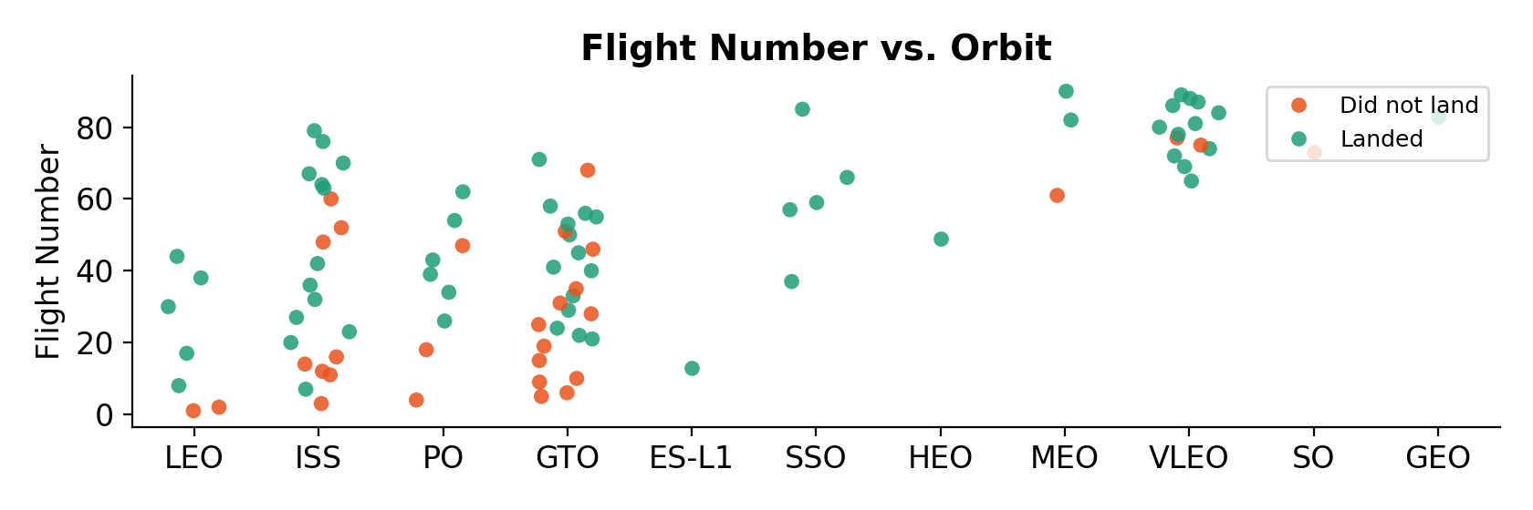
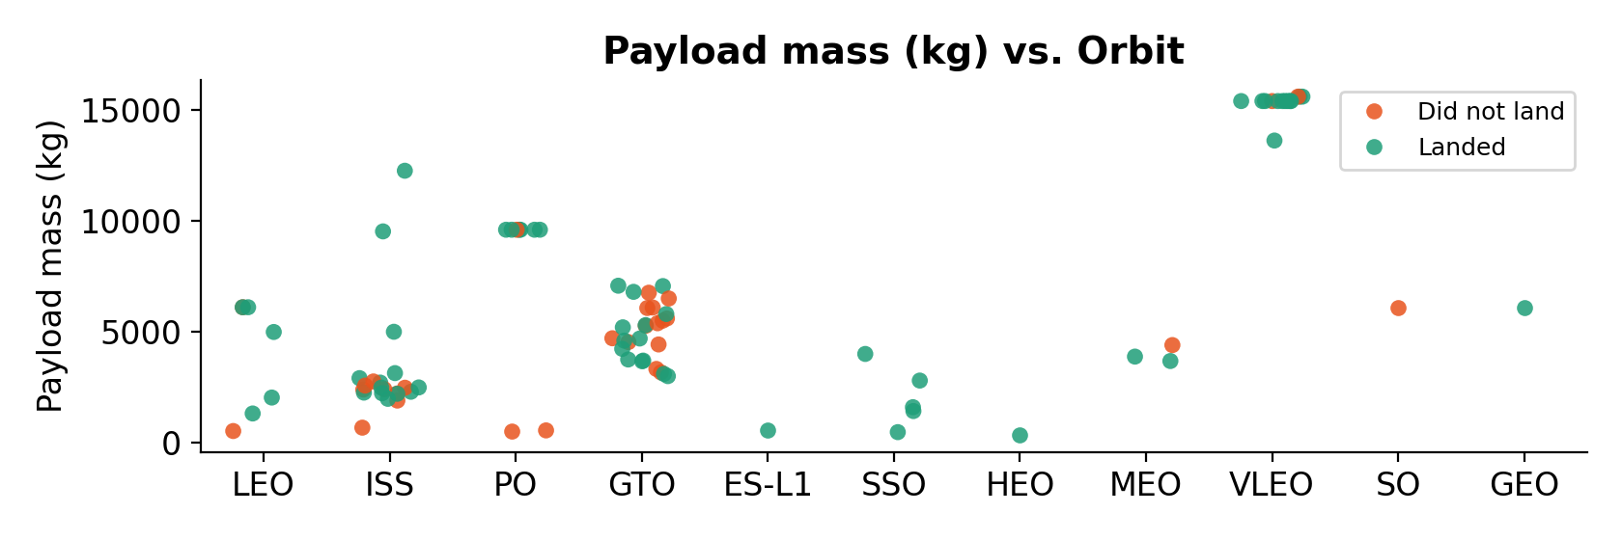
EDA: Flight Number and Payload vs. Orbit
WHAT IT SHOWS
Two scatter plots comparing orbits by experience (flight number) and by payload mass.
INSIGHT
In LEO, success grows with flight number (correlation 0.72); in GTO the link is weaker (0.43). The 15 launches above 10,000 kg (14 in VLEO, 1 in ISS) landed 87% of the time.

Slide 18
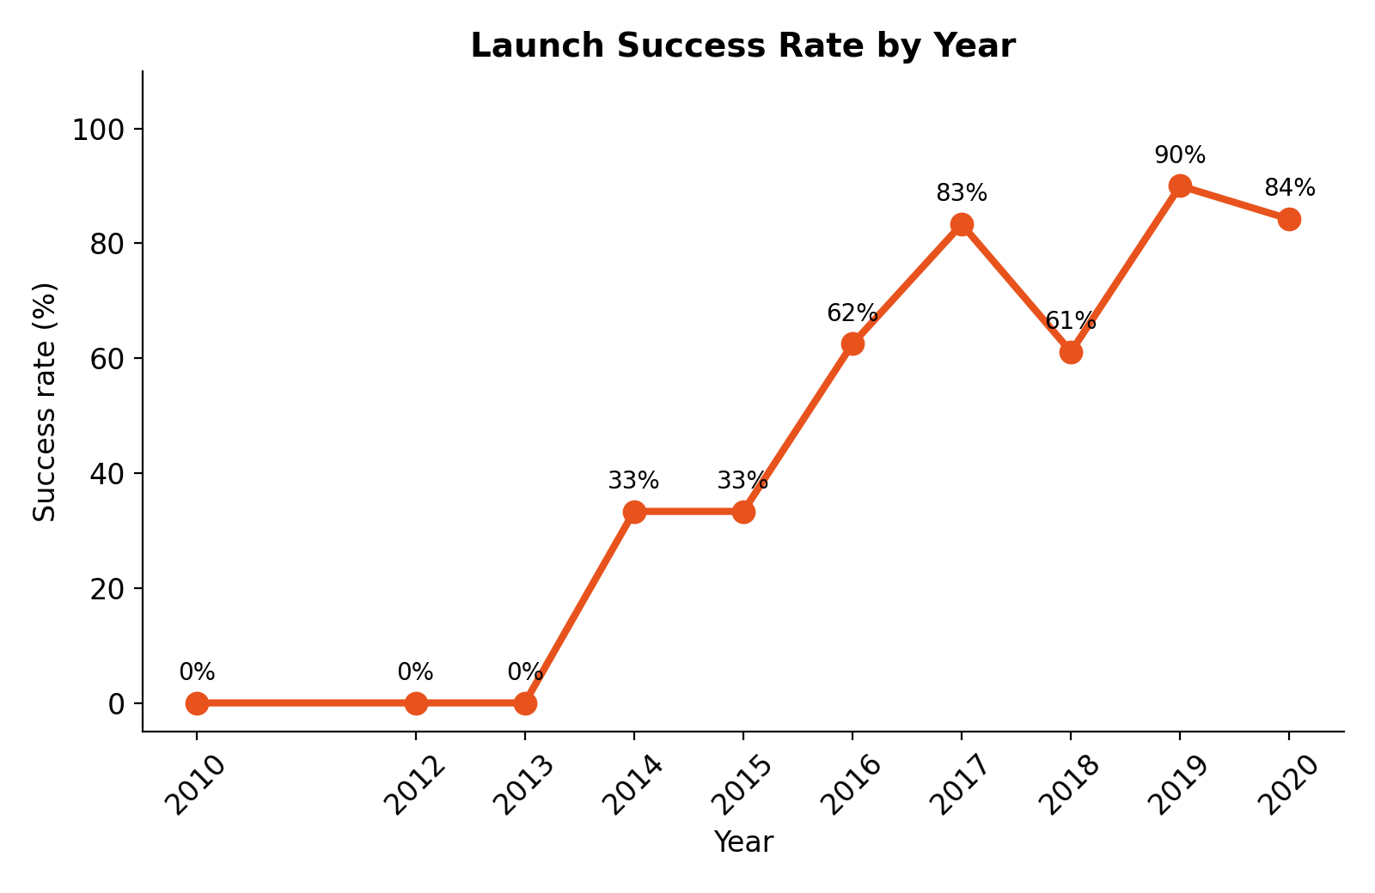
EDA: Yearly Launch Success Trend
WHAT IT SHOWS
The share of launches that landed in each year.
INSIGHT
Success climbs from 0% in 2013 to 84% in 2020, peaking at 90% in 2019, with a dip to 61% in 2018.

Slide 19
EDA with SQL: Launch Sites
Q1 Display the unique launch site names
WHAT IT SHOWS
SELECT DISTINCT Launch_Site FROM SPACEXTBL
The distinct launch sites, and a preview of launches from sites starting with "CCA".
Launch_Site
CCAFS LC-40
VAFB SLC-4E
KSC LC-39A
CCAFS SLC-40
INSIGHT
Q2 5 records where launch sites begin with "CCA"
Four distinct sites: CCAFS LC-40, VAFB SLC-4E, KSC LC-39A and CCAFS SLC-40. The first two launches (2010) carried 0 kg of payload.
SELECT Date, Booster_Version, Launch_Site, PAYLOAD_MASS__KG_ FROM SPACEXTBL WHERE Launch_Site LIKE 'CCA%' LIMIT 5
Date | Booster_Version | Launch_Site | Payload (kg)
2010-06-04 | F9 v1.0 B0003 | CCAFS LC-40 | 0
2010-12-08 | F9 v1.0 B0004 | CCAFS LC-40 | 0
2012-05-22 | F9 v1.0 B0005 | CCAFS LC-40 | 525
2012-10-08 | F9 v1.0 B0006 | CCAFS LC-40 | 500
2013-03-01 | F9 v1.0 B0007 | CCAFS LC-40 | 677

Slide 20
EDA with SQL: Payload and First Landing
Q3 Total payload mass carried by boosters launched by NASA (CRS)
45,596 kg
WHAT IT SHOWS
SELECT SUM(PAYLOAD_MASS__KG_) AS total_payload_kg FROM SPACEXTBL WHERE Customer = 'NASA (CRS)'
Total payload for NASA (CRS), the average payload of F9 v1.1, and the date of the first ground-pad landing.
Q4 Average payload mass carried by booster version F9 v1.1
2,928.4 kg
SELECT AVG(PAYLOAD_MASS__KG_) AS avg_payload_kg FROM SPACEXTBL WHERE Booster_Version = 'F9 v1.1'
INSIGHT
NASA (CRS) missions carried 45,596 kg in total. F9 v1.1 boosters averaged 2,928.4 kg. The first successful ground-pad landing was on 22 December 2015.
Q5 Date of the first successful landing on a ground pad
2015-12-22
SELECT MIN(Date) AS first_ground_pad_landing FROM SPACEXTBL WHERE Landing_Outcome = 'Success (ground pad)'

Slide 21
EDA with SQL: Boosters and Mission Outcomes
Q6 Boosters with drone-ship success and payload between 4,000 and 6,000 kg
WHAT IT SHOWS
SELECT DISTINCT Booster_Version FROM SPACEXTBL WHERE Landing_Outcome = 'Success (drone ship)' AND PAYLOAD_MASS__KG_ > 4000 AND PAYLOAD_MASS__KG_ < 6000
Boosters that landed on a drone ship with a mid-range payload, and the count of each mission outcome.
Booster_Version
F9 FT B1022
F9 FT B1026
F9 FT B1021.2
F9 FT B1031.2
INSIGHT
Four Falcon 9 FT boosters landed on a drone ship with payloads of 4,000 to 6,000 kg. Of 101 missions, 99 succeeded, 1 had an unclear payload status and 1 failed in flight.
Q7 Total number of successful and failed mission outcomes
SELECT Mission_Outcome, COUNT(*) AS total FROM SPACEXTBL GROUP BY Mission_Outcome
Mission_Outcome | Total
Failure (in flight) | 1
Success | 99
Success (payload status unclear) | 1

Slide 22
EDA with SQL: Heaviest Payload and 2015 Failures
Q8 Boosters that carried the maximum payload mass
WHAT IT SHOWS
SELECT DISTINCT Booster_Version FROM SPACEXTBL WHERE PAYLOAD_MASS__KG_ = (SELECT MAX(PAYLOAD_MASS__KG_) FROM SPACEXTBL)
Boosters that carried the maximum payload (15,600 kg), and the failed drone-ship landings of 2015.
Booster_Version | Booster_Version
F9 B5 B1048.4 | F9 B5 B1049.5
F9 B5 B1049.4 | F9 B5 B1060.2
F9 B5 B1051.3 | F9 B5 B1058.3
F9 B5 B1056.4 | F9 B5 B1051.6
F9 B5 B1048.5 | F9 B5 B1060.3
F9 B5 B1051.4 | F9 B5 B1049.7
INSIGHT
12 booster flights carried the maximum payload, all Block 5 (B5). Two drone-ship landings failed in 2015: January (B1012) and April (B1015), both from CCAFS LC-40.
Q9 2015 failed drone-ship landings: month, booster, launch site
SELECT substr(Date, 6, 2) AS month, Landing_Outcome, Booster_Version, Launch_Site FROM SPACEXTBL WHERE Landing_Outcome = 'Failure (drone ship)' AND substr(Date, 1, 4) = '2015'
month | Landing_Outcome | Booster_Version | Launch_Site
January | Failure (drone ship) | F9 v1.1 B1012 | CCAFS LC-40
April | Failure (drone ship) | F9 v1.1 B1015 | CCAFS LC-40

Slide 23
EDA with SQL: Landing Outcome Ranking
Q10 Rank landing outcomes between 2010-06-04 and 2017-03-20 (descending)
WHAT IT SHOWS
SELECT Landing_Outcome, COUNT(*) AS total FROM SPACEXTBL WHERE Date BETWEEN '2010-06-04' AND '2017-03-20' GROUP BY Landing_Outcome ORDER BY total DESC
Landing outcomes between 2010-06-04 and 2017-03-20, counted and ranked in descending order.
Landing_Outcome | Total
No attempt | 10
Success (drone ship) | 5
Failure (drone ship) | 5
Success (ground pad) | 3
Controlled (ocean) | 3
Uncontrolled (ocean) | 2
Failure (parachute) | 2
Precluded (drone ship) | 1
INSIGHT
"No attempt" was the most common outcome (10). Drone-ship successes and failures tied at 5 each, ahead of ground-pad successes (3).

Slide 24
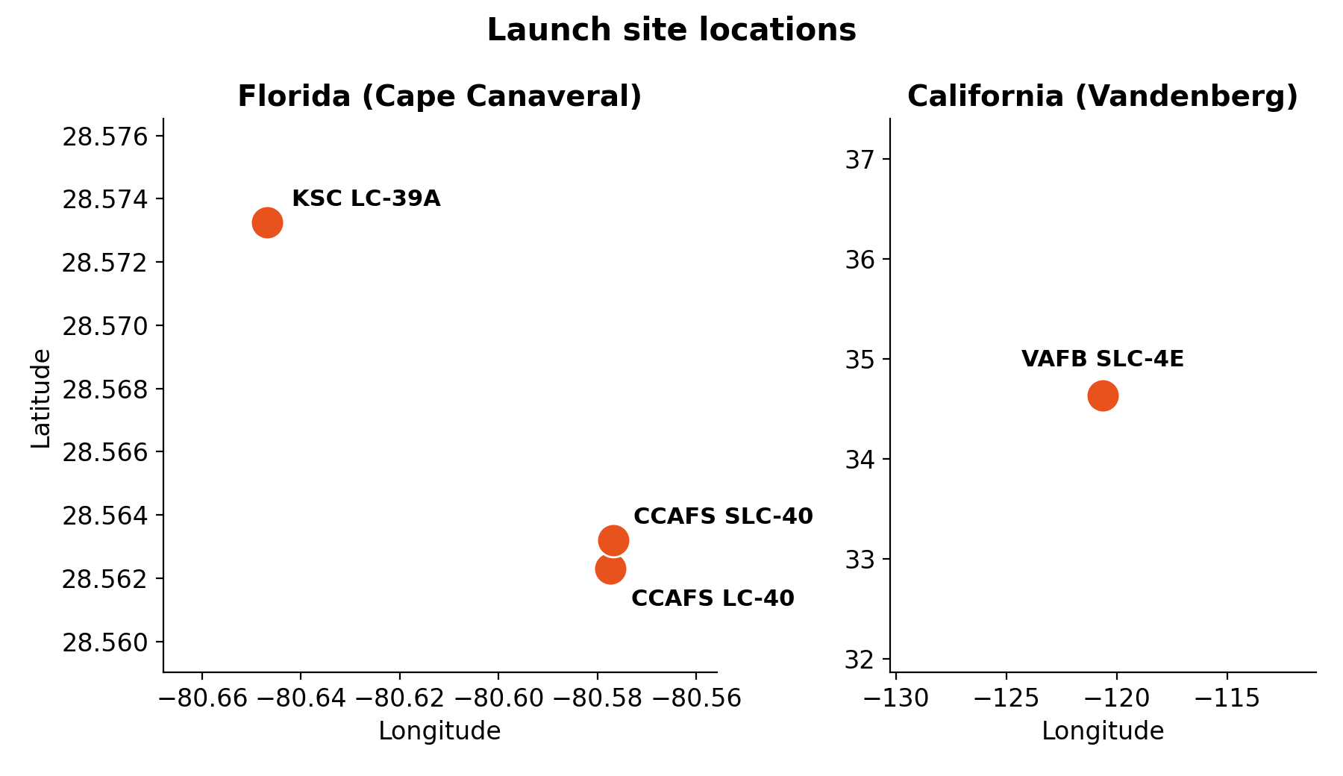
Folium Map: Launch Site Locations
WHAT IT SHOWS
Launch sites plotted by latitude and longitude, as marked on the Folium map. Static view; the interactive map is in the notebook.
INSIGHT
Three sites sit together at Cape Canaveral, Florida (CCAFS LC-40, CCAFS SLC-40, KSC LC-39A). The fourth, VAFB SLC-4E, is in California. All four are on the US coast.

Slide 25
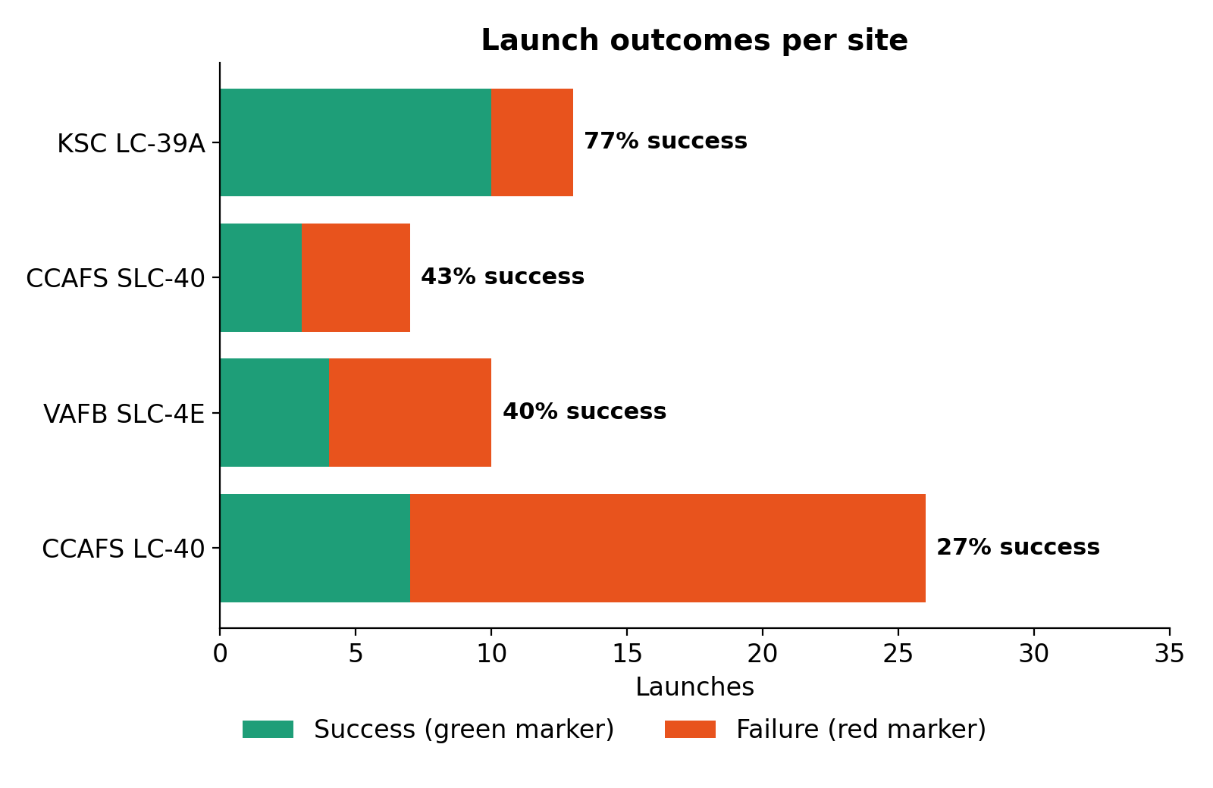
Folium Map: Launch Outcomes per Site
WHAT IT SHOWS
Green markers are successful landings and red markers are failures at each site. Static view of the marker counts.
INSIGHT
KSC LC-39A has the best record: 10 of 13 launches landed (77%). CCAFS LC-40 has the weakest, 7 of 26 (27%), and hosts the earliest launches.

Slide 26
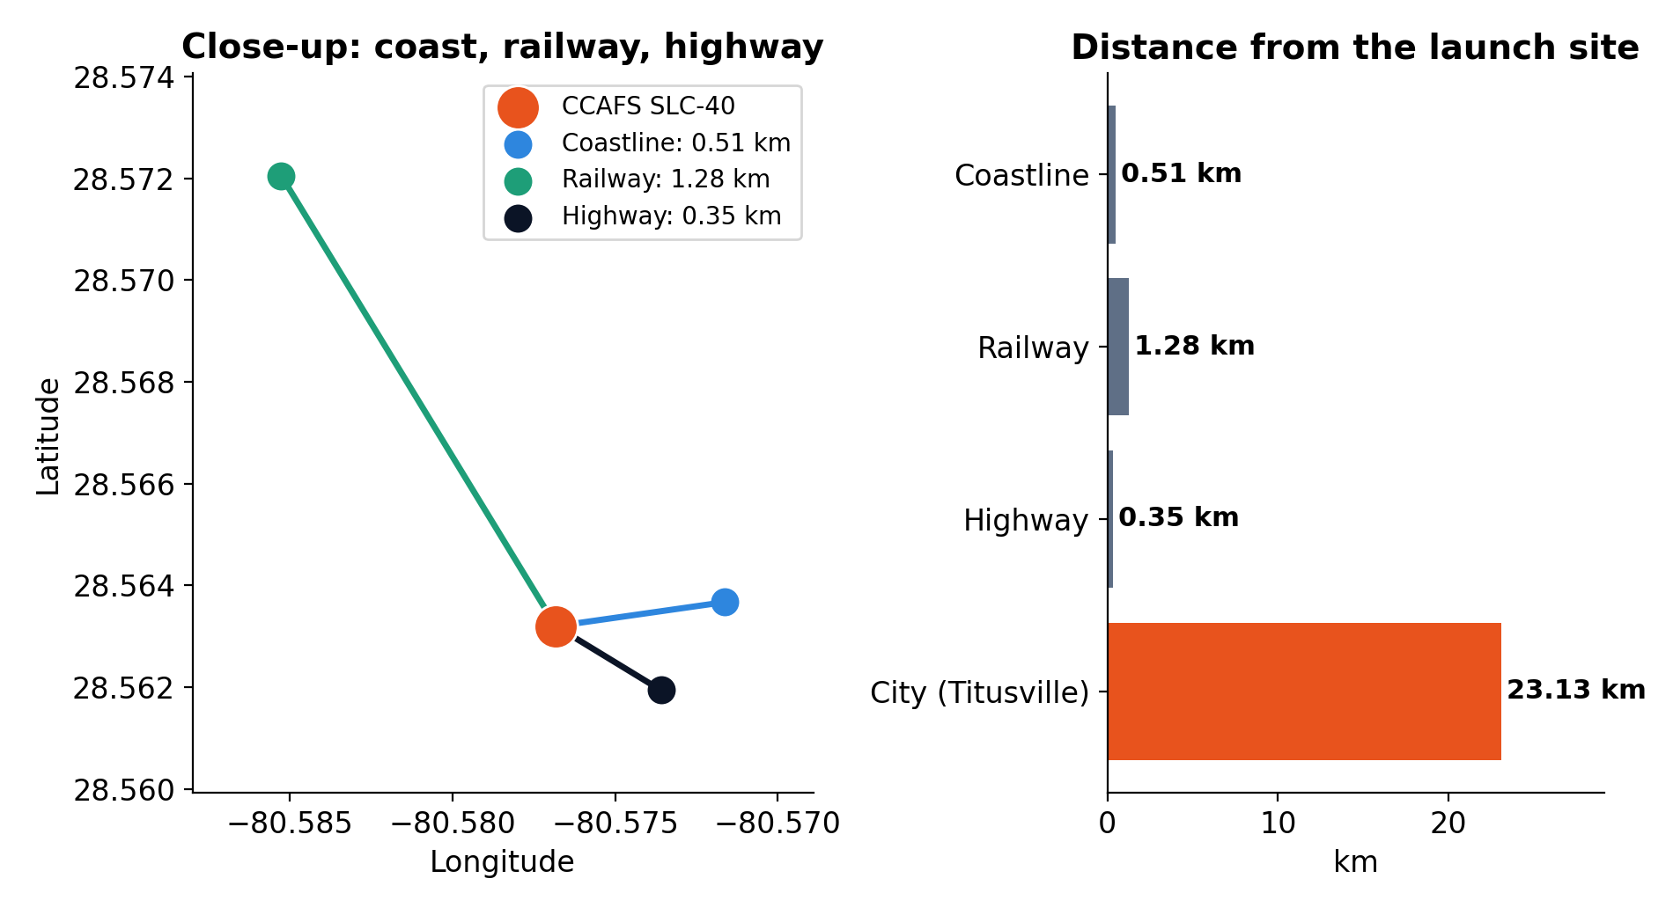
Folium Map: Proximity Analysis
WHAT IT SHOWS
Distances from CCAFS SLC-40 to the nearest coastline, railway, highway and city, as drawn with lines on the Folium map.
INSIGHT
The site is 0.51 km from the coast, 1.28 km from a railway and 0.35 km from a highway, but 23 km from the nearest city (Titusville). Proximity points are approximate.

Slide 27
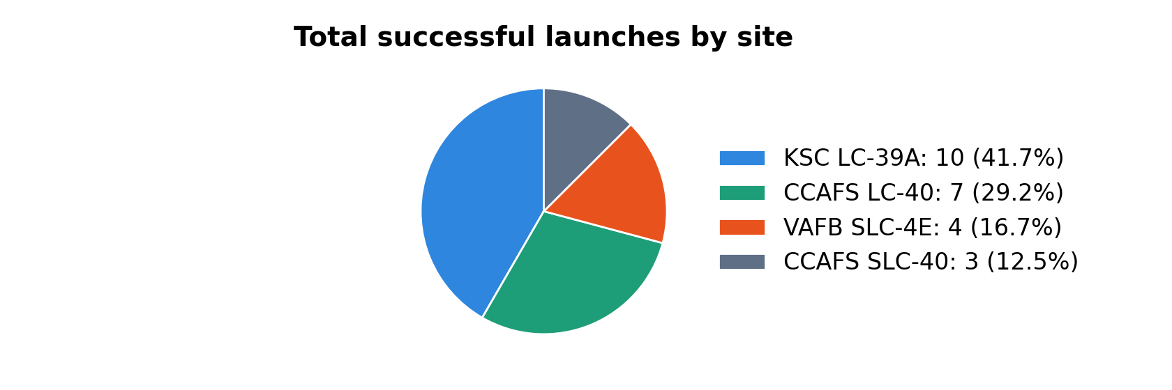
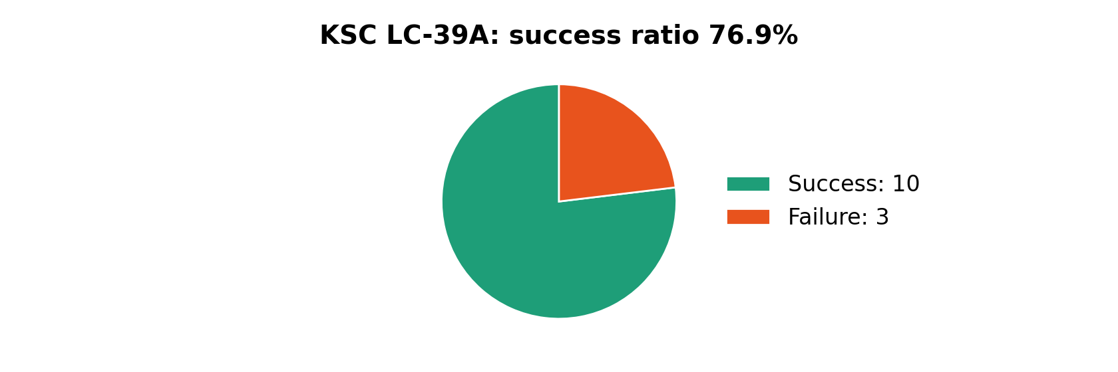
Plotly Dash: Launch Success by Site
WHAT IT SHOWS
The two pie charts of the dashboard: successful launches per site (top), and success vs failure for the site with the best ratio (bottom).
INSIGHT
KSC LC-39A holds the largest share of successful launches (10 of 24, 41.7%) and the best success ratio (76.9%).

Slide 28
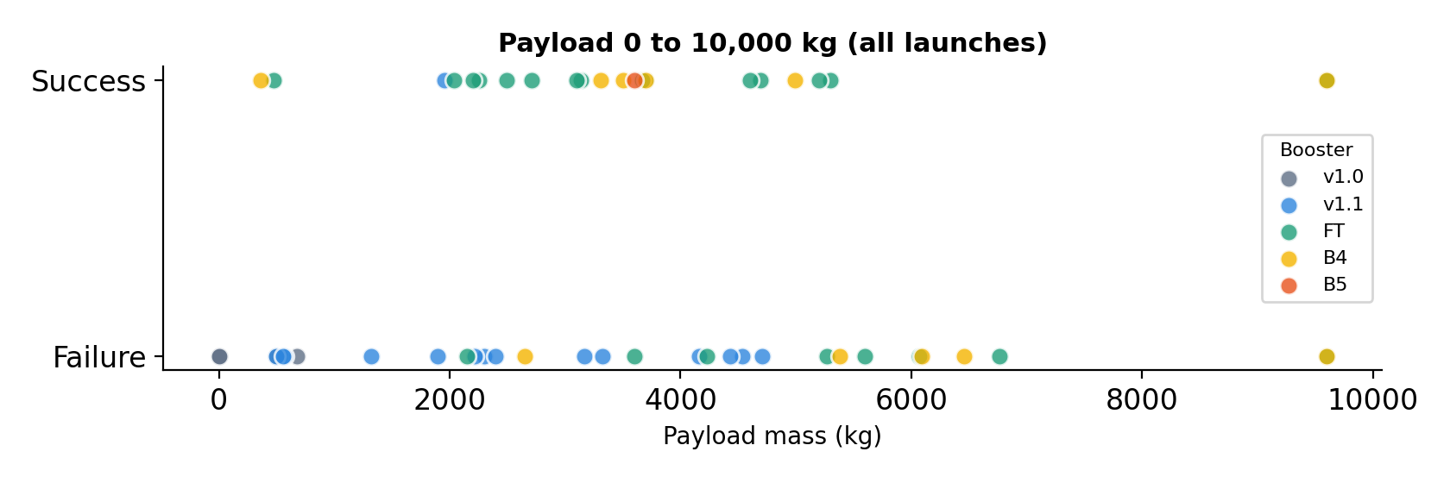
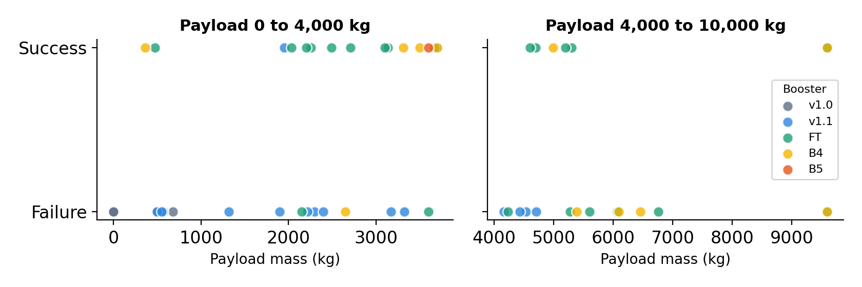
Plotly Dash: Payload vs. Outcome
WHAT IT SHOWS
Payload mass against outcome, coloured by booster version, filtered with the payload range slider.
INSIGHT
Launches with 0 to 4,000 kg landed 47% of the time (n=34) vs 36% for 4,000 to 10,000 kg (n=22). By booster, FT lands 67% (n=24); v1.0 and v1.1 rarely landed (0% and 7%).

Slide 29
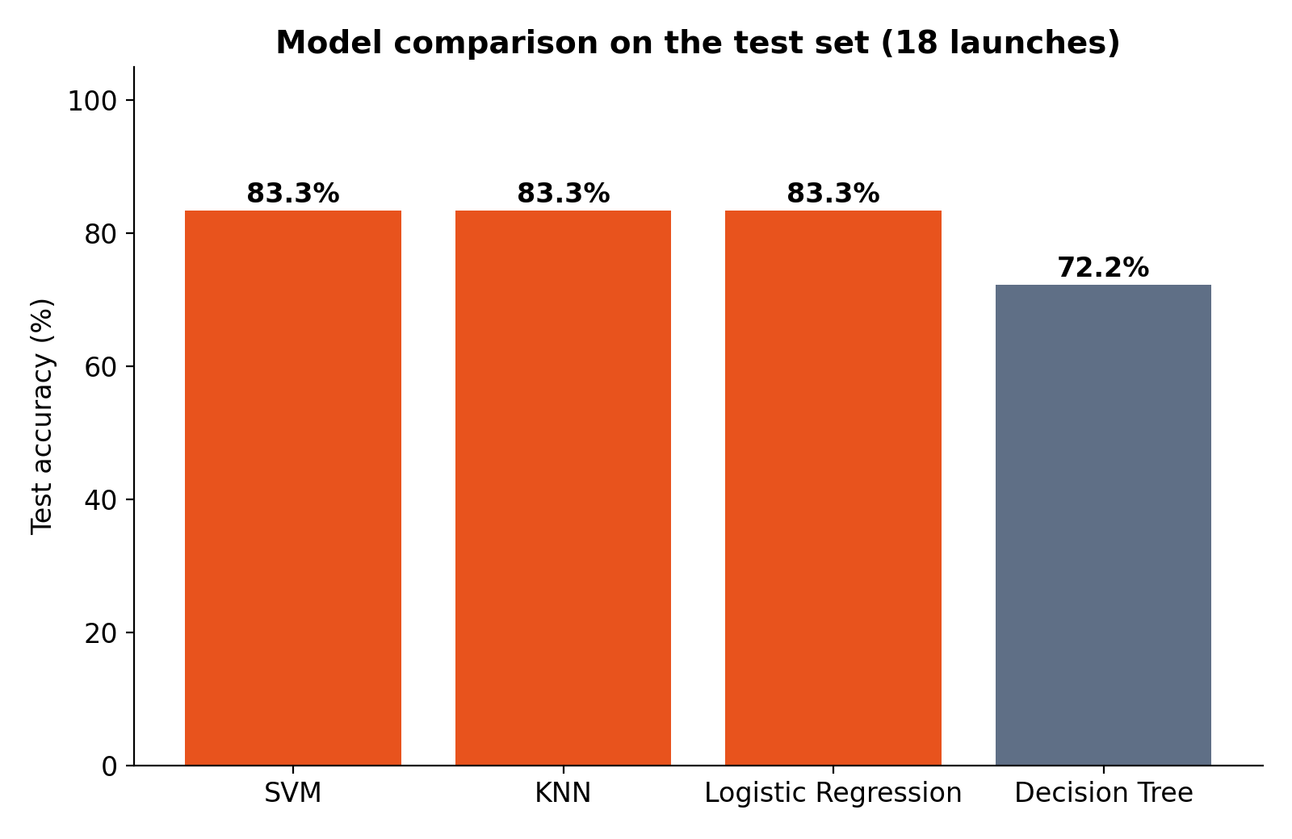
Predictive Analysis: Model Comparison
WHAT IT SHOWS
Test-set accuracy of each tuned classifier: Logistic Regression, SVM, Decision Tree and KNN.
INSIGHT
SVM, KNN and Logistic Regression tie at 83.3% test accuracy; the Decision Tree reaches 72.2%. SVM is selected for its best cross-validation accuracy (84.8%).

Slide 30
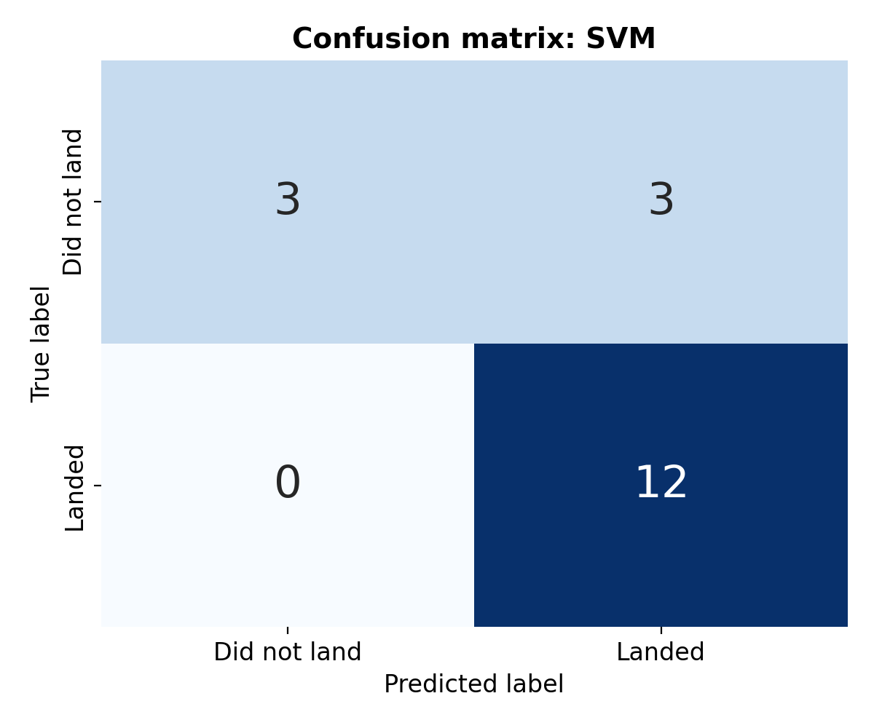
Predictive Analysis: Confusion Matrix
WHAT IT SHOWS
True vs predicted landing outcomes for the best model on the 18 test launches.
INSIGHT
12 true positives, 3 true negatives, 3 false positives and 0 false negatives. The model never misses a landing but sometimes predicts a landing that fails.

Slide 31



Innovative Insights
Reuse pays for itself
Experience compounds
Context beats one factor
FINDING
FINDING
FINDING
A landed first stage supports the gap between $165M and $62M launch prices.
Success rises from 0% (2013) to 84% (2020); in LEO it tracks flight number (correlation 0.72).
GTO lands 52% of the time vs 86% for VLEO, and KSC LC-39A lands 77% vs 27% at CCAFS LC-40.
SO WHAT
SO WHAT
SO WHAT
Expected saving ≈ P(landing) × ~$100M. At the historical 66.7% landing rate that is about $67M per launch; a model probability makes it launch-specific.
Early flights drag down naive averages; model booster maturity, not just orbit.
No single factor explains a landing; the models combine orbit, site, payload and booster.

Slide 32

Conclusion
Landing success is predictable
Success improves with experience
SVM, KNN and Logistic Regression reach 83.3% test accuracy.
The yearly landing rate rose from 0% in 2013 to 84% in 2020.
Context matters
Limits and next steps
Orbit, launch site, payload and booster version all shift the odds.
Only 90 launches and 18 test samples. Add more data, weather and reuse-count features, and probability outputs.

Slide 33
Appendix: GitHub Links
Deliverable | Link
Repository (all notebooks and code) | github.com/itsdimash/IBM-Data-Science-Capstone-SpaceX
Data collection: SpaceX API | github.com/itsdimash/IBM-Data-Science-Capstone-SpaceX/blob/main/jupyter-labs-spacex-data-collection-api.ipynb
Data collection: web scraping | github.com/itsdimash/IBM-Data-Science-Capstone-SpaceX/blob/main/jupyter-labs-webscraping.ipynb
Data wrangling | github.com/itsdimash/IBM-Data-Science-Capstone-SpaceX/blob/main/labs-jupyter-spacex-Data-wrangling.ipynb
EDA with SQL | github.com/itsdimash/IBM-Data-Science-Capstone-SpaceX/blob/main/SpaceX_Capstone_Analysis.ipynb
EDA with data visualization | github.com/itsdimash/IBM-Data-Science-Capstone-SpaceX/blob/main/SpaceX_Capstone_Analysis.ipynb
Folium map | github.com/itsdimash/IBM-Data-Science-Capstone-SpaceX/blob/main/lab_jupyter_launch_site_location_completed.ipynb
Plotly Dash app | github.com/itsdimash/IBM-Data-Science-Capstone-SpaceX/blob/main/spacex_dash_app.py
Predictive analysis | github.com/itsdimash/IBM-Data-Science-Capstone-SpaceX/blob/main/SpaceX_Capstone_Analysis.ipynb

Slide 34
Appendix: Model Details
Model | Best hyperparameters (GridSearchCV, cv=10) | CV accuracy | Test accuracy
Logistic Regression | C=1, penalty=l2, solver=lbfgs | 82.1% | 83.3%
SVM | C=1, gamma=0.0316, kernel=sigmoid | 84.8% | 83.3%
Decision Tree | criterion=gini, max_depth=10, max_features=sqrt, min_samples_leaf=1, min_samples_split=2, splitter=random | 83.4% | 72.2%
KNN | algorithm=auto, n_neighbors=6, p=1 | 83.4% | 83.3%
Split: 72 training and 18 test launches (test_size 0.2, random_state 2), features standardized with StandardScaler. With 18 test launches, one launch changes accuracy by 5.6 points, so the tie between three models should be read with care.

